Slide 1
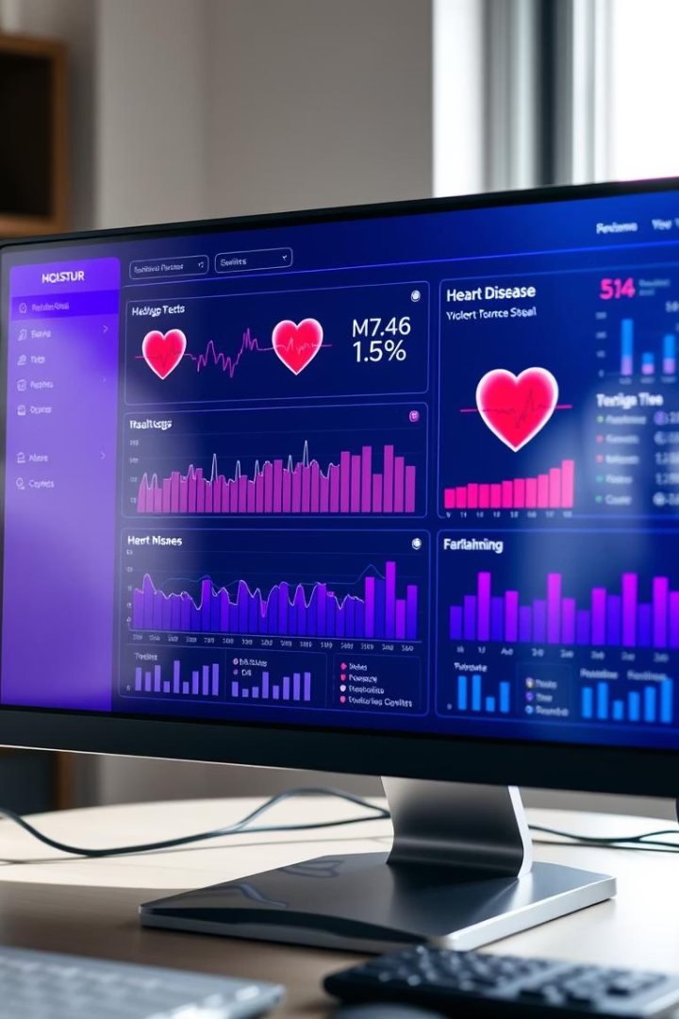

Heart Disease Risk Dashboard
This dashboard analyzes heart disease risk factors interactively.
It empowers healthcare professionals with insightful data visualizations.
by Muzzamil Ali

Slide 2
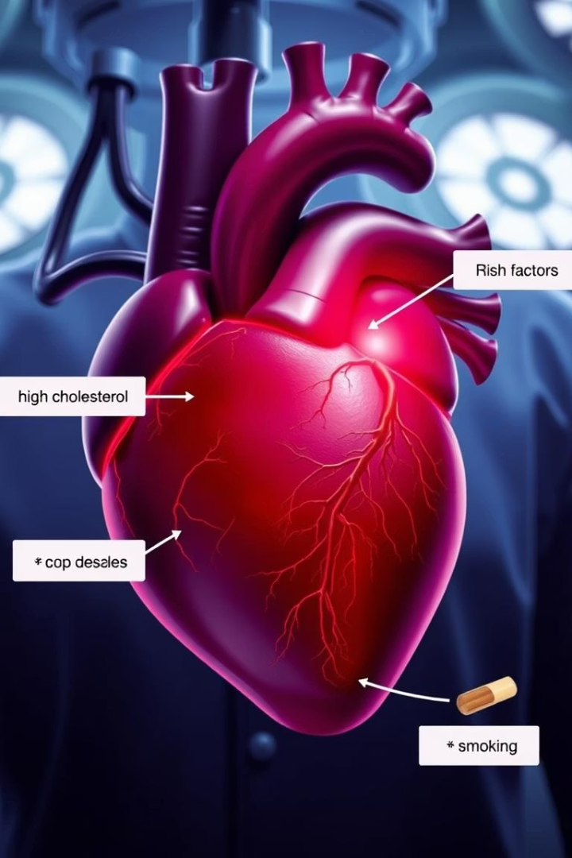
Understanding the Problem
Leading Cause of Death
Importance of Risk Factors
Heart disease remains a top global killer.
Early detection of risk factors is crucial for prevention.
Limitations of Existing Tools
Many tools lack interactivity and depth.

Slide 3

Interactive Data Filtering
Age Group Filters
Gender Filters
Risk Factors
Select specific age ranges for targeted analysis.
Compare risk distributions between males and females.
Focus on cholesterol, blood pressure, smoking, and more.

Slide 4
Comprehensive Visualizations
Pie Charts
Bar Charts
Line Charts
Display proportion of risk factors prevalence.
Show comparison across demographics and factors.
Illustrate trends over time or age groups.

Slide 5




Machine Learning Prediction
Random Forest Model
Trained on comprehensive heart disease data.
User Input
Personal data enhances prediction accuracy.
Risk Prediction
Gives personalized heart disease risk assessment.

Slide 6

Key Insights from Dashboard
Enhanced Understanding
Personalized Risk
Machine learning enables tailored health advice.
Interactive tools deepen risk factor insight.
Data-Driven Decisions
Visualizations support clinical and research choices.

Slide 7

Future Enhancements
Expand Dataset
Include diverse populations for broader relevance.
Improve Model
Add features to boost prediction accuracy.
Real-time Data
Enable live updates for dynamic analysis.

Slide 8

Summary and Next Steps
Interactive filtering boosts insight
Machine learning personalizes risk
Users explore detailed heart disease risk factors.
Enables targeted preventive health strategies.
Future focus on inclusivity and real-time data
Enhancing dashboard impact and clinical utility.

